Slide 1
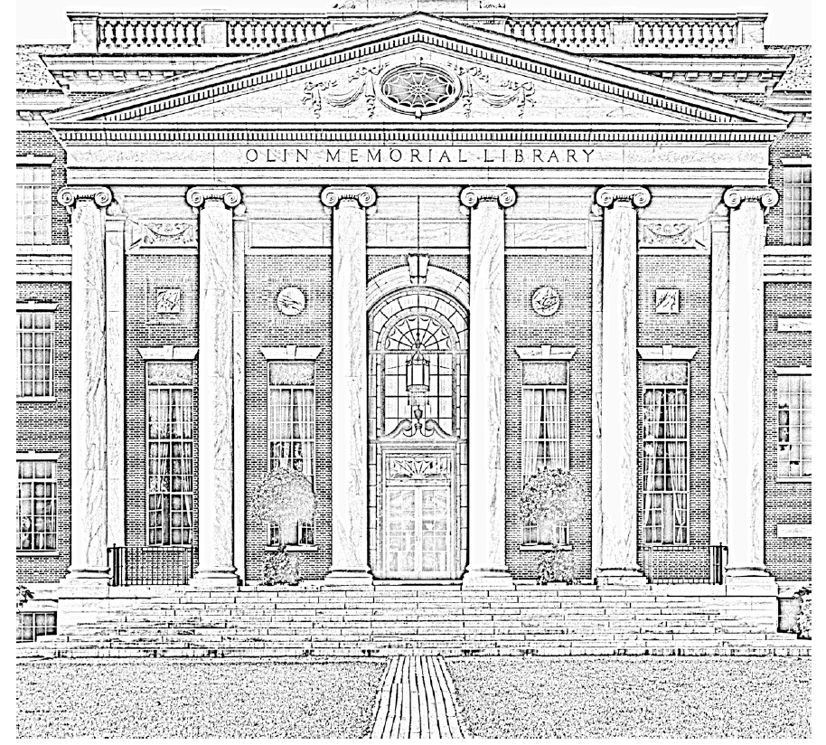

Creating Primo VE Normalization Rules for External Data Sources
Lori Stethers Systems Librarian, Wesleyan University lstethers@wesleyan.edu https://github.com/lstethers/primove-normrules/
ELUNA, May 2024
Notes:
This QR code goes to my github which has this presentation, a related presentation I gave last year, and the normalization rules we are using at my institution.
You’ll see images in this presentation primarily from our institutional repository, image credits in the speaker notes.
Image from: http://library.nyam.org/colorourcollections/wp-content/uploads/sites/5/2018/02/WesleyanUniversity_ColorOurCollections_2018.pdf
Olin Memorial Library, 1928, Vertical Files Photograph Collection, Special Collections & Archives, Wesleyan University
Presentation Abstract:
To ingest external data sources such as LibGuides, ArchivesSpace, and institutional repositories into Primo VE for discovery by your users, you will need to map and transform data as a part of that ingest process. To map and transform data, you need to use discovery normalization rules. In this session, learn to create and test discovery normalization rules for external data sources. Learn both Dublin Core and XML rule syntax, and why you might choose one over the other for your rules. See real-life examples of rules created for processing Islandora, LibGuides, ArchivesSpace, and Figshare data sources. Prior to the conference, attendees will have the opportunity to submit their own examples of data transformations they would like to have addressed in the presentation.
Ex Libris Product(s) related to this session:
Primo VE
Learning Outcome #1:
Identify when to use Dublin Core and when to use XML normalization rules
Learning Outcome #2
Create and test both Dublin Core and XML normalization rules
Learning Outcome #3
Explain how discovery normalization rules relate to resource types

Slide 2
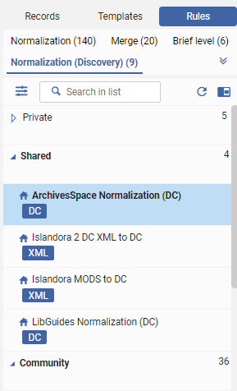
This presentation is …
About Discovery Normalization Rules
for importing external data sources into Primo VE
Beginner to Intermediate level
Somewhat code-heavy
Notes:
First, what this presentation is and is not
It is…
About discovery normalization rules for external data sources
What does that mean?
They are rules for transforming the data from outside sources such as LibGuides, FigShare, Islandora, Digital Commons, ArchivesSpace
Into Dublin Core data that Primo VE then uses for search, facets, and display. You write these rules to tell Primo how to treat the data from your external sources.
This is for beginner to intermediate users, so I’ll go through setting up these normalization rules, how they fit into the import process overall, and then get into some specific rule examples and how to test your rules
It will be code-heavy when I get into the rule examples. If you aren’t interested in writing rules yourself this presentation isn’t right for you

Slide 3
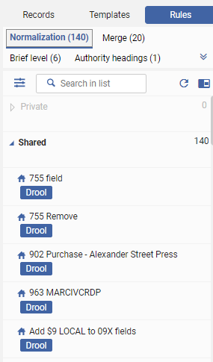
This presentation is not …
Alma Normalization Rules for your MARC records
X
Setting up Discovery Import Profiles
Notes:
before we get started…
you might already be familiar with normalization rules for MARC records in Alma
those are different from discovery normalization rules.
I’m not going to cover the entire process of setting up a Discovery Import Profile
I did cover that last year …

Slide 4
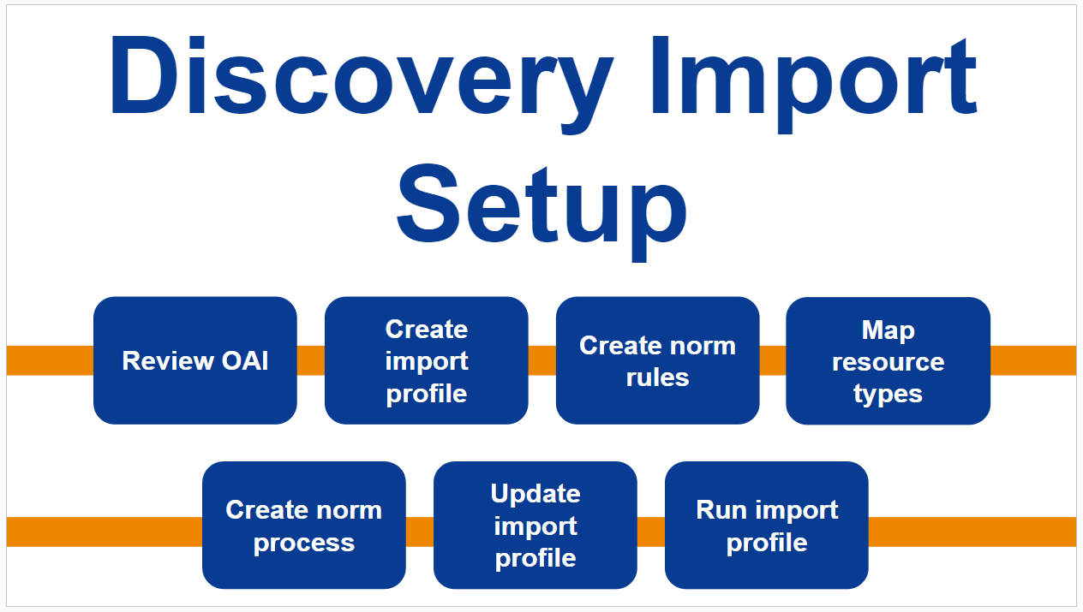
Last year’s topic …
Stethers, Lori (2023) Ingest Institutional Repository Content to Primo VE via OAI-PMH.
https://documents.el-una.org/id/eprint/2223/ https://github.com/lstethers/primove-normrules/
We’re covering just the highlighted parts today
Notes:
Last year’s presentation that you can refer to to see the entire setup process for external discovery import is in the ELUNA document repository, also available in my github at the QR code I gave on the opening slide
Stethers, Lori (2023) Ingest Institutional Repository Content to Primo VE via OAI-PMH. and at https://github.com/lstethers/primove-normrules/tree/main/presentation-files
Today we’ll be covering in more depth the 3 highlighted boxes, but not necessarily in that order

Slide 5






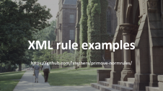
Agenda
Notes:
Here is what we’ll be covering today

Slide 6

Creating Discovery Normalization Rules
Notes:
Image from: https://digitalcollections.wesleyan.edu/object/upc-650
Scenic [College Row], 1959, University Photographer’s Collection, Special Collections & Archives, Wesleyan University.

Slide 7
Create New Normalization Rule (animation)
Alma > Config > Discovery > Loading External Data Sources > Normalization Rules for External Data Sources > New > Normalization (Discovery)
Access Level:
Private or Shared
Type:
DC or XML
Animation of process: https://drive.google.com/file/d/1Ve2UiNKunJsDCMlEBwK19Pak4k3Mm8Zq/view?usp=drive_link
Notes:
Here is how you get into the Normalization Rule editor to start creating norm rules.
Alma > Config > Discovery > Loading External Data Sources > Normalization Rules for External Data Sources > New > Normalization (Discovery)
While we’re in here, I’ll point out the Community section where you can see rules other institutions have shared.
There are a couple of choices you’ll need to make while setting up the rule.
I’ll talk in a moment about whether to choose DC or XML rule type
Access Level: you can keep it private while you are writing and testing the rule, but you must choose Shared if you want to use this in a Normalization Process and Discovery Import Profile
A Private rule is only available to your specific user. Choosing Shared on the rule does not add it to the Community, it just makes it Shared your institution.

Slide 8
Dublin Core or XML rules?
Dublin Core
XML
default field mappings predefined
limited evaluations and transformations
simple and easy to understand
no default field mappings defined
with XPath expressions, many evaluations and transformations possible
syntax can be challenging to understand
helpful to learn some XPath
Notes:
If you don’t have DC data, you have to use XML norm rules.
If you do have DC data, you can choose whether to use DC or XML rules. There may be circumstances where you want to use XML norm rules on your DC data..
However you have to choose one or the other for the data source, you can’t mix and match XML and DC rules for one data source.
DC – default field mappings defined so you only have to write rules where you want to do something different than the defaults vs. XML you have to specify every field you want to bring into Primo
You’ll see later on an example where I needed to use XML rules to accomplish what I wanted even though I had DC data.
Documentation: https://knowledge.exlibrisgroup.com/Primo/Product_Documentation/020Primo_VE/Primo_VE_(English)/100Loading_Records_from_External_Sources_into_Primo_VE/Configuring_Normalization_Rules_for_External_Resources_(Primo_VE)#Normalization_Rule_Syntax_for_DC_and_XML_Formats

Slide 9
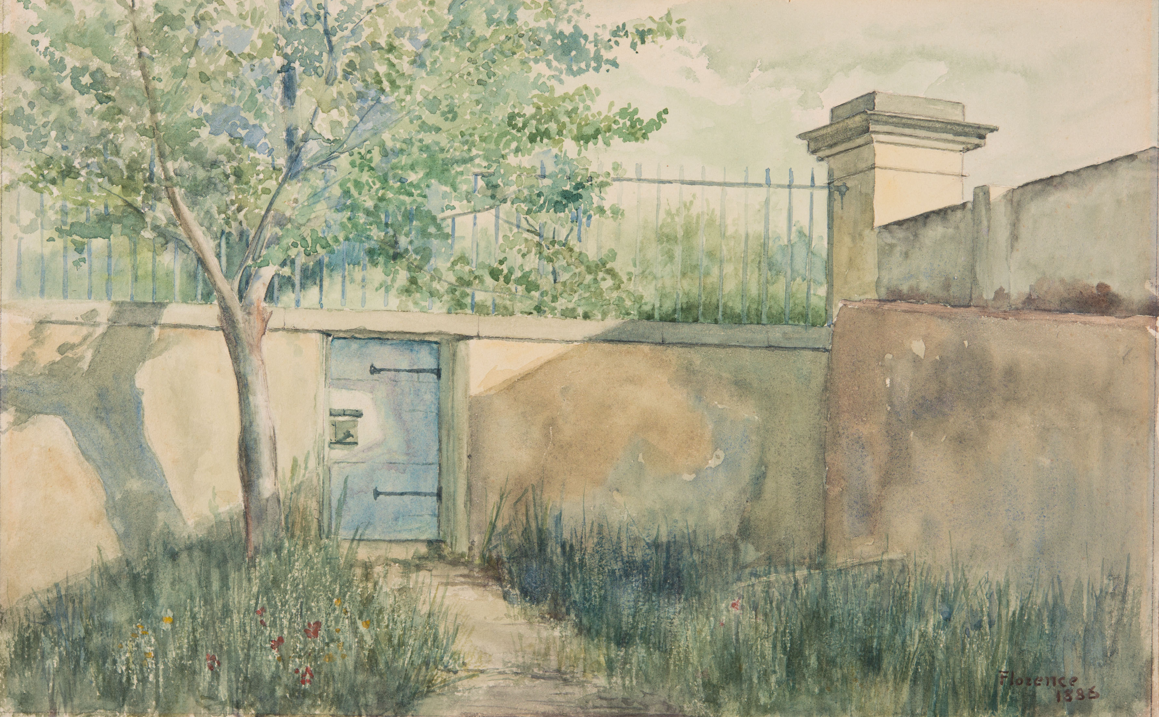
The parts of a rule (DC and XML)
// comment
/* multi-line comment */
rule "rule name"
when
condition1 AND
(condition2 OR
condition3)
then
action1
action2
end
Notes:
Documentation: https://knowledge.exlibrisgroup.com/Primo/Product_Documentation/020Primo_VE/Primo_VE_(English)/100Loading_Records_from_External_Sources_into_Primo_VE/Configuring_Normalization_Rules_for_External_Resources_(Primo_VE)#Normalization_Rule_Syntax_for_DC_and_XML_Formats
Image from: https://digitalcollections.wesleyan.edu/islandora/09001011-door-wall-garden-front
Bacon, Henry. Door in wall with garden, front. 1886-1924. Henry Bacon Papers, Series VI: Personal, Subseries VI B: Sketches and watercolors of European scenes. Special Collections & Archives, Wesleyan University.

Slide 10
Dublin Core rule examples
https://github.com/lstethers/primove-normrules/
Notes:
I’m going to be showing code during this part. I’ll be showing examples from portions of my normalization rule sets. To see the full rule set, see my github.
The full normalization rules that I’ll be referencing are in github here: https://github.com/lstethers/primove-normrules/
Image from: https://digitalcollections.wesleyan.edu/object/upc-650
Scenic [College Row], 1959, University Photographer’s Collection, Special Collections & Archives, Wesleyan University.

Slide 11
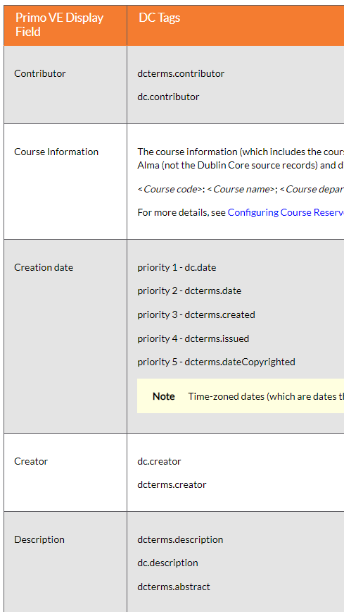
DC Default Mappings
Fields will be mapped as described in the “Mapping to the Display, Facets, and Search Sections in the Primo VE Record“ doc (Dublin Core section)
You only need to add DC norm rules if you want to change the defaults.
Notes:
You might have some tags that don’t get mapped by default so you should always double check.
https://knowledge.exlibrisgroup.com/Primo/Product_Documentation/020Primo_VE/Primo_VE_(English)/120Other_Configurations/Mapping_to_the_Display%2C_Facets%2C_and_Search_Sections_in_the_Primo_VE_Record#Dublin_Core

Slide 12
DC rule set example: LibGuides
rule "add OA indication"
when
True
then
set "Unrestricted online access" in "dcterms"."accessRights"
end
rule "add research_guide resource type"
when
True
then
set "research_guide" in "dc"."type"
end
rule "add Research Guide to end of title"
when
True
then
set TEMP"1" to dc value "dc"."title"
add suffix (TEMP"1"," Research Guide")
set "dc"."title" to TEMP"1"
end
With DC rules, you only need to specify the fields you want to transform.
Notes:
Example of a DC rule set.
This is my full DC rule set for ingesting our LibGuides.
I do very little to our LibGuides ingest, so there are just 3 rules in my set..
The other fields are just mapped using the Ex Libris defaults, so I don’t have to specify rules for them.
Now to get into the specifics of building rules…

Slide 13
DC rule example: condition: “True” + action: “set” to constant value
// assign open access indicator on all records
rule "add OA indication"
when
true
then
set "Unrestricted online access" in "dcterms"."accessRights"
end
apply to every record
set constant value in this field
Notes:
On my LibGuides I add an OpenAccess indicator to all records.
breaking down what you see here:
“when True” → so apply the rule to every record
set a static value of “Unrestricted online access” in the dcterms.accessRights field

Slide 14
DC rule example: condition: “exist” + action: “move”
// move value from dc.coverage to dc.subject
rule "move dc.coverage to dc.subject"
when
exist "dc"."coverage"
then
move "dc"."coverage" to "dc"."subject"
end
when this field exists
move it to dc.subject
Notes:
This is something I’m doing on our ArchivesSpace records.
Our ArchivesSpace sends a value in dc.coverage, but we want it to end up in dc.subject for Primo.
Breaking down what you see here:
when the dc.coverage field exists
move its value to dc.subject

Slide 15
DC rule example: condition: “not equals”
// change the publisher field to Wesleyan University for all existing publisher fields
rule "override all dc.publisher values"
when
"dc"."publisher" not equals "Wesleyan University"
then
set "Wesleyan University" in "dc":"publisher"
end
when dc.publisher is not set to the value we want
set it
Notes:
This is something I’m doing on our ArchivesSpace records.
We want the publisher for all of our ArchivesSpace records in Primo to be “Wesleyan University”, but ArchivesSpace is sending something else for some records
breaking down what you see here:
when dc.publisher is not equal to Wesleyan University
set it to Wesleyan University

Slide 16
DC rule example: actions: TEMP variable + a transformation
// append Research Guide to end of title // e.g. Political Science becomes Political Science Research Guide
set TEMP"1" to dc value "dc"."title"
add suffix (TEMP"1"," Research Guide")
set "dc"."title" to TEMP"1"
put the dc.title value in TEMP1 variable
add suffix text to TEMP1
set dc.title to the new value of TEMP1
Notes:
Here is another example from LibGuides.
I add “Research Guide” to the end of the title. For example, I want to change the title from “Political Science” to “Political Science Research Guide” to give it more context when it is discovered by a user in Primo.
To do this you need to use a TEMP variable.
For reasons I don’t know, you can’t do transformation actions on the dc fields themselves. you have to transfer their values to a temporary variable, operate on that, then transfer the resulting value back to a dc field.
create a TEMP1 variable and put the value of dc.title in it
add the text “ Research Guide” to the end of the title in the TEMP1 variable – using add suffix, which is a transformation available to us
set dc. title to the value of the TEMP1 variable

Slide 17
XML rule examples
https://github.com/lstethers/primove-normrules/
Notes:
A note on using XPath expressions: you can only use XPATH version 1.0 functions (https://github.com/primousers/primo-ve-norm/wiki/3.-Known-Issue-with-Discovery-Import-Norm-Rules)
Image from: https://digitalcollections.wesleyan.edu/object/upc-650
Scenic [College Row], 1959, University Photographer’s Collection, Special Collections & Archives, Wesleyan University.

Slide 18
XML rule set example: Islandora 2
rule "Contributor"
when
exist "//*[local-name()='contributor']/text()"
then
copy "//*[local-name()='contributor']/text()" to
"dc"."contributor"
end
rule "Coverage"
when
exist "//*[local-name()='coverage']/text()"
then
copy "//*[local-name()='coverage']/text()" to "dc"."coverage"
end
rule "Date"
when
exist "//*[local-name()='date']/text()"
then
copy "//*[local-name()='date']/text()" to "dc"."date"
end
rule "Format"
when
exist "//*[local-name()='format']/text()"
then
copy "//*[local-name()='format']/text()" to "dc"."format"
end
rule "Main identifier (from record header)"
when
exist "//*[local-name()='record']/*[local-name()='header']/*[local-name()='identifier']"
… and on and on and on
With XML rules, all fields must be explicitly specified to appear in the Primo VE record.
Notes:
Example of an XML rule set. This is just a small portion of this rule set.
With XML rules you are transforming the XML to DC fields for Primo.
You have to explicitly say which field you are moving each into because there are no default mappings for XML
*Even* if you are starting with DC data, if you are using XML rules, you must map each field.
Now to get into the specifics of some rules…

Slide 19
XML rule example: condition: exist + action: copy
// move Contributor value to dc.contributor
rule "Contributor"
when
exist "//*[local-name()='contributor']/text()"
then
copy "//*[local-name()='contributor']/text()" to "dc"."contributor"
end
wherever contributor field exists
copy it to dc.contributor
Notes:
Here is a very basic XML example. Note that you have to use Xpath to get to the data here.
Our Islandora records have a dc.contributor field that we want to map to dc.contributor in Primo
breaking down what you see here:
contributor field exists
copy its value to dc.contributor
If there are multiple Contributor fields in the XML record, you only need to specify the rule once, it will act on every matching field

Slide 20
XML rule example: XPath to use data from record header
rule "Main identifier (from record header)"
when
exist "//*[local-name()='record']/*[local-name()='header']/*[local-name()='identifier']"
then
copy "//*[local-name()='record']/*[local-name()='header']/*[local-name()='identifier']/." to "dc"."identifier"
end
When identifier field exists in header
copy it to dc.identifier
Notes:
This is from our Islandora records.
I’m using a more specific XPATH to target just the identifier element that’s in the record header,
rather than any identifier field in the metadata portion of the record

Slide 21
XML rule example: operators and parentheses
when
exist "//*[local-name()='rights']/text()"
AND
(exist "//*[local-name()='rights'][(contains(text(),'No Copyright - United States'))]“
OR
exist "//*[local-name()='rights'][(contains(text(),'No Known Copyright'))]")
then
set "Unrestricted online access" in "dcterms"."accessRights"
wherever rights field exists
and contains either of these values
set constant value in dcterms.accessrights
Notes:
I’m going to start showing you only the when… then portions from here on out to be able to show more on a page
For our Islandora records, we want to add an OpenAccess indicator only under certain circumstances, based upon the value in the “rights” field.
breaking down what you see here:
when the ‘rights’ field exists
and
it contains either ‘No Copyright - United States’ or ‘No Known Copyright’ <- note that you can uses parentheses to group the logic
in this case, setting the value in the dc field is the same as it was in DC rules

Slide 22
XML rule example: XPath functions
when
exist "//*[local-name()='subject'][not(contains(.,'LH1.W45 A6'))]"
then
copy "//*[local-name()='subject'][not(contains(.,'LH1.W45 A6'))]" to "dc"."subject"
end
whenever subject does not contain this text
copy it to dc.subject
Notes:
The records for our school newspaper have a subject identifier that has the newspaper’s shelving call number in it.
We don’t want that to appear in the digital records as a subject, so here we’re copying all subjects EXCEPT those that contain the call number
this is an example of using some XPATH conditions in your rules – not and contains here are XPATH functions

Slide 23
XML rule example: Xpath element occurences
when
exist "//*[local-name()='title'][1]/text()"
then
copy "//*[local-name()='title'][1]/text()" to "dc"."title"
end
copy the first occurrence of the title to dc.title
Notes:
We want only the first occurrence of the title field to be placed in dc.title (the rest will go into dcterms.alternative, see next slide)
Here we are using Xpath notation to indicate we want only the first occurrence of the title element – the [1] after the title

Slide 24
XML rule example: Xpath element occurrences + Xpath function
when
exist "//*[local-name()='title'][position()>1]/text()"
then
copy "//*[local-name()='title'][position()>1]/text()" to "dcterms"."alternative"
end
copy every occurrence after the first occurrence of title to dcterms.alternative
Notes:
Now we’ll assign the other occurrences of the title element.
Here we are using Xpath “position” function to get the element position, then we evaluate it to determine if it is greater than 1.
Title position > 1 — so any occurrence of the title after the first one will be copied to dcterms.alternative

Slide 25
XML rule example: TEMP variable + a regular expression transformation
// remove parentheses and number from Creator
// e.g. Jane Doe (123456) becomes Jane Doe
set TEMP"1" to xpath "//*[local-name()='creator']/text()“
remove substring using regex (TEMP"1","\\s*(\\d*)$")
set TEMP"1" in "dc"."creator"
put the creator value in TEMP1 variable
use ‘remove substring’ action with regex to remove matching text
set dc.creator to the new value of TEMP1
Notes:
This is an example for our Figshare repository.
The creator values come from Figshare with a number in parentheses after the person’s name.
I want to remove the number and parentheses.
I’m using a normalization rule transformation (“remove substring using regex”) with a regular expression to remove the space, parentheses, and number at the end of the string.
NOTE:
https://github.com/primousers/primo-ve-norm/wiki/3.-Known-Issue-with-Discovery-Import-Norm-Rules -- only certain regular expression escape sequences are supported

Slide 26
Norm Rules and Resource Types
Notes:
Image from: https://digitalcollections.wesleyan.edu/object/upc-650
Scenic [College Row], 1959, University Photographer’s Collection, Special Collections & Archives, Wesleyan University.

Slide 27
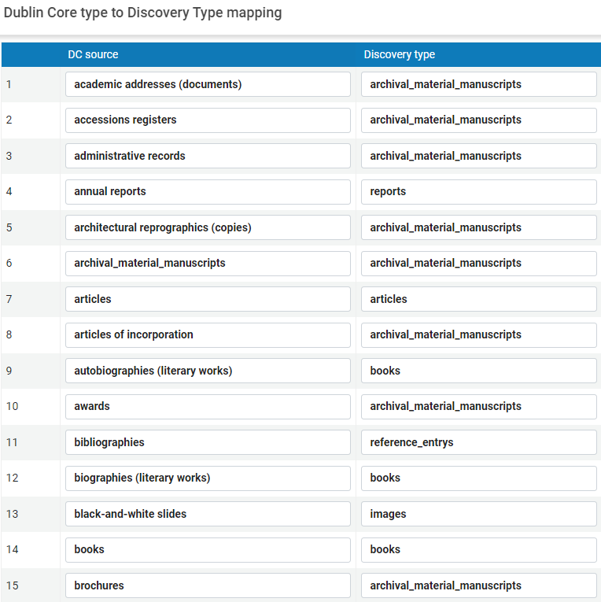
DC Fields and and resource types
discovery:resourceType
dcterms:type + Dublin Core Type to Discovery Type Mapping
dc:type + Dublin Core Type to Discovery Type Mapping
Notes:
For external data sources, Primo VE chooses resource type in this order.
So you can set any of these 3 values in your norm rules:
discovery:resourceType field
dcterms:type field – then looks it up in Dublin Core Type to Discovery Type Mapping
dc:type field then looks it up in Dublin Core Type to Discovery Type Mapping
If you use dccterms:type or dc:type make sure you also map that value in the mapping table
If no matching resource type found in the mapping table, uses the value set as default in the mapping table (this is how you end up with a bunch of stuff set as “Other”)
Alma Config > Discovery > Loading External Data Sources > Dublin Core Type to Discovery Type Mapping
Documentation:
https://knowledge.exlibrisgroup.com/Primo/Product_Documentation/020Primo_VE/Primo_VE_(English)/100Loading_Records_from_External_Sources_into_Primo_VE/Configuring_Normalization_Rules_for_External_Resources_(Primo_VE)#Mapping_Resource_Types_from_External_Data_Sources
https://knowledge.exlibrisgroup.com/Primo/Product_Documentation/020Primo_VE/Primo_VE_(English)/100Loading_Records_from_External_Sources_into_Primo_VE/Using_the_Mapping_Table_to_Map_Resource_Types

Slide 28
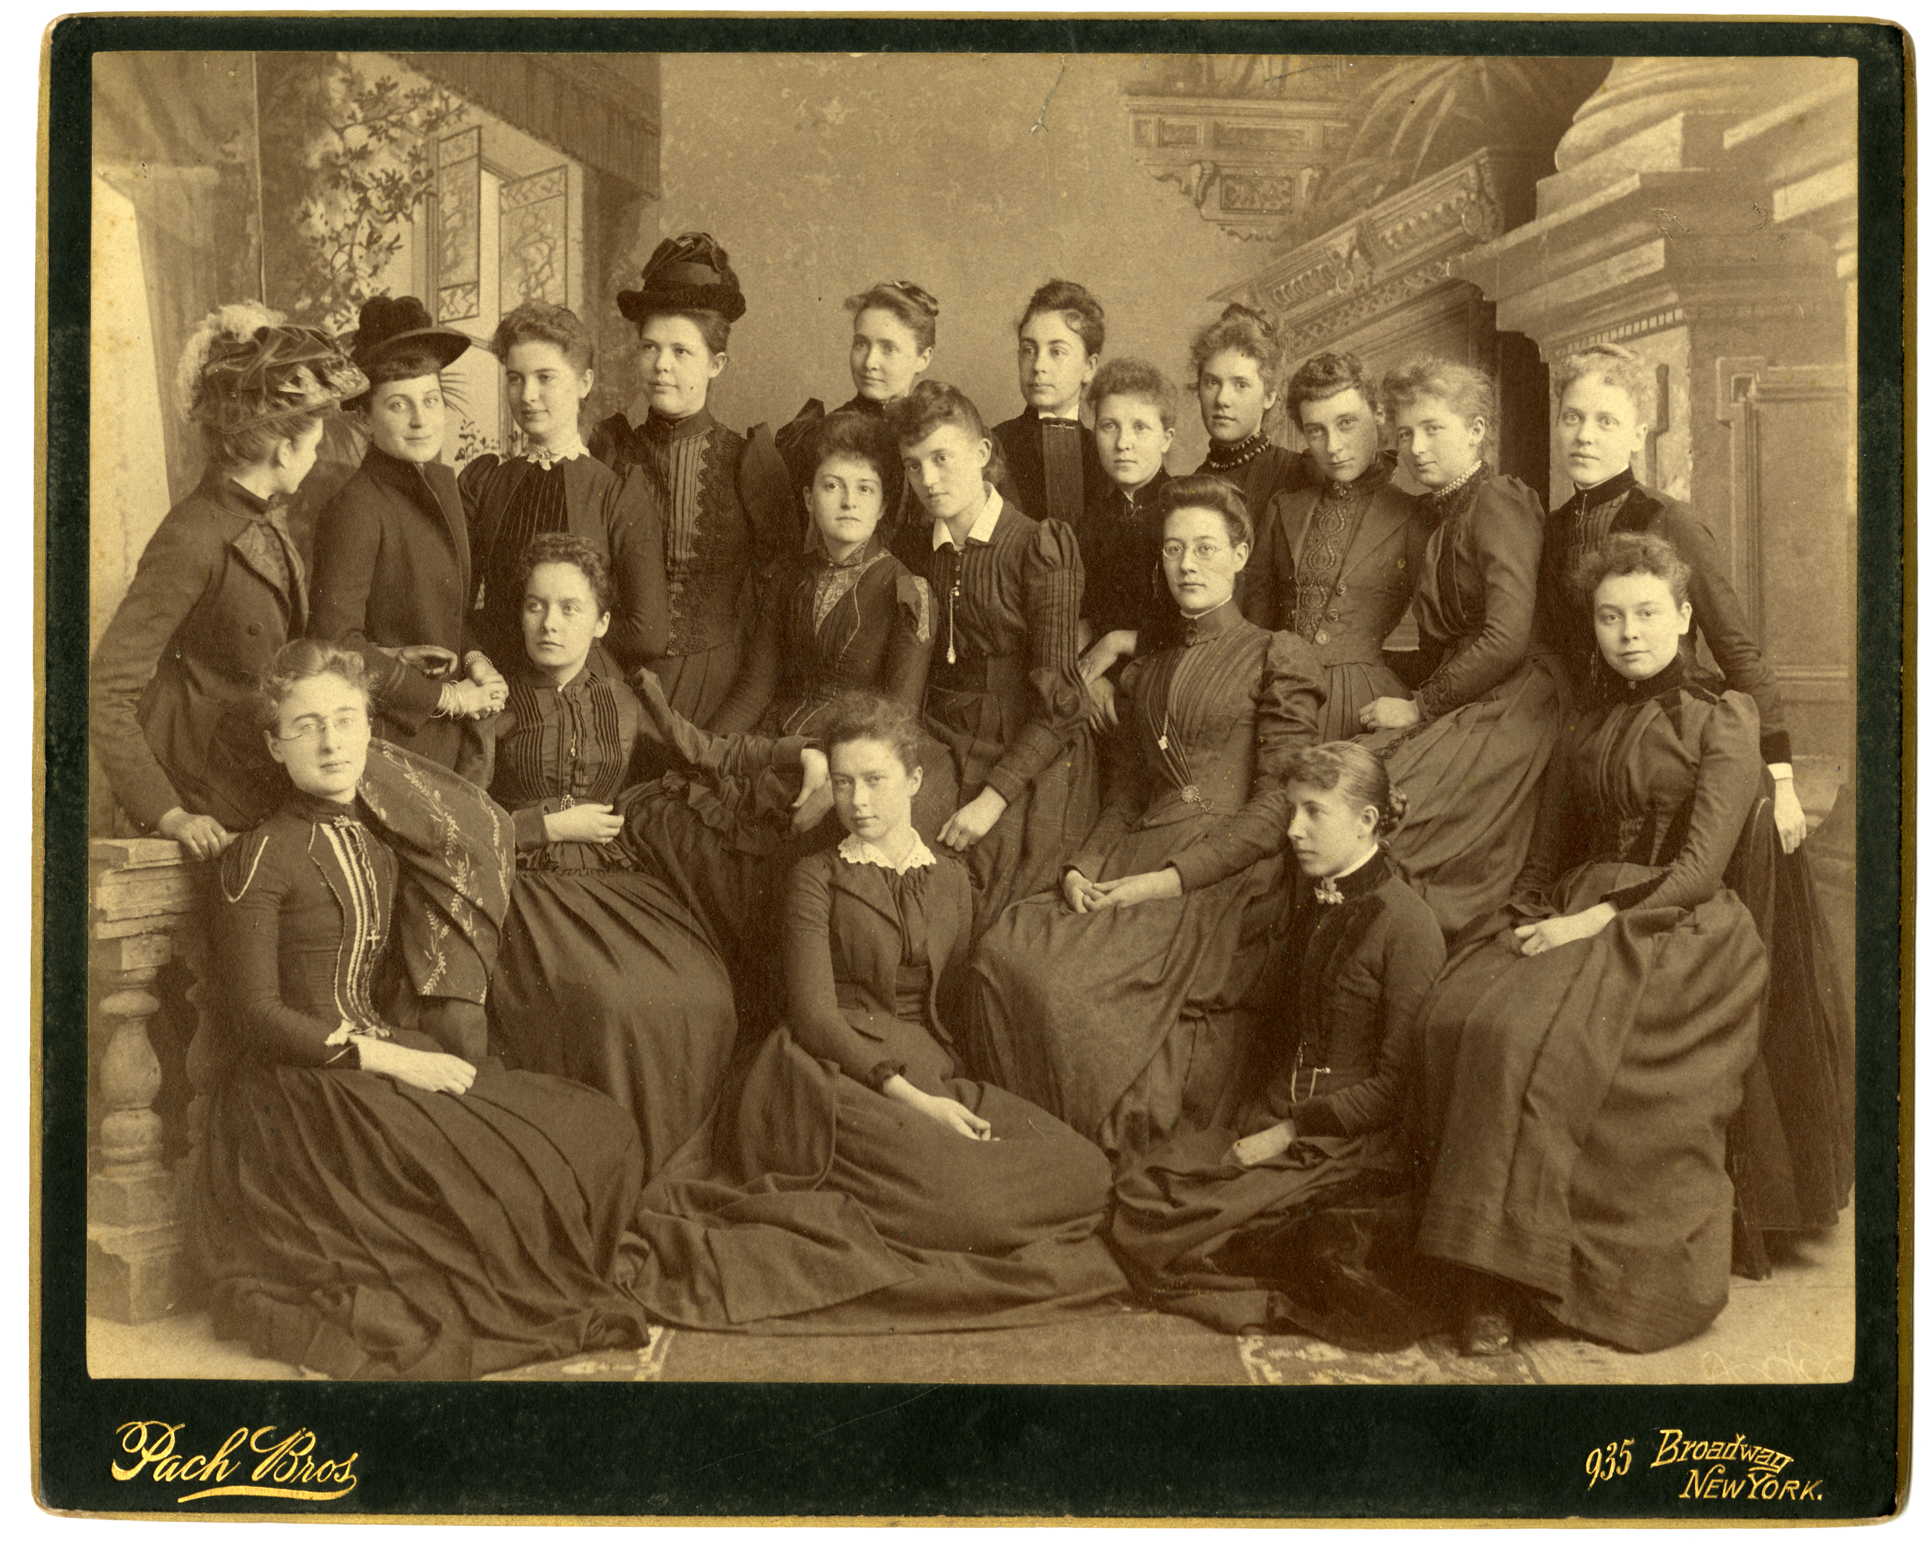
Set constant resource type
rule “set resource type of Archives”
when
true
then
set “archival_material_manuscipts” in “dc”:”type”
end
Notes:
Archivesspace records - I want to setting a static resource type value for all of the records.
Here you’d also need to have archival_material_manuscripts in the Dublin Core Type to Discovery Type Mapping table
Image from: https://digitalcollections.wesleyan.edu/object/coeducation-13
Unidentified group photo of Wesleyan women. Pach Bros (January 01, 1890). Coeducation Collection, Box 2, Folder 3, Special Collections & Archives, Wesleyan University.

Slide 29
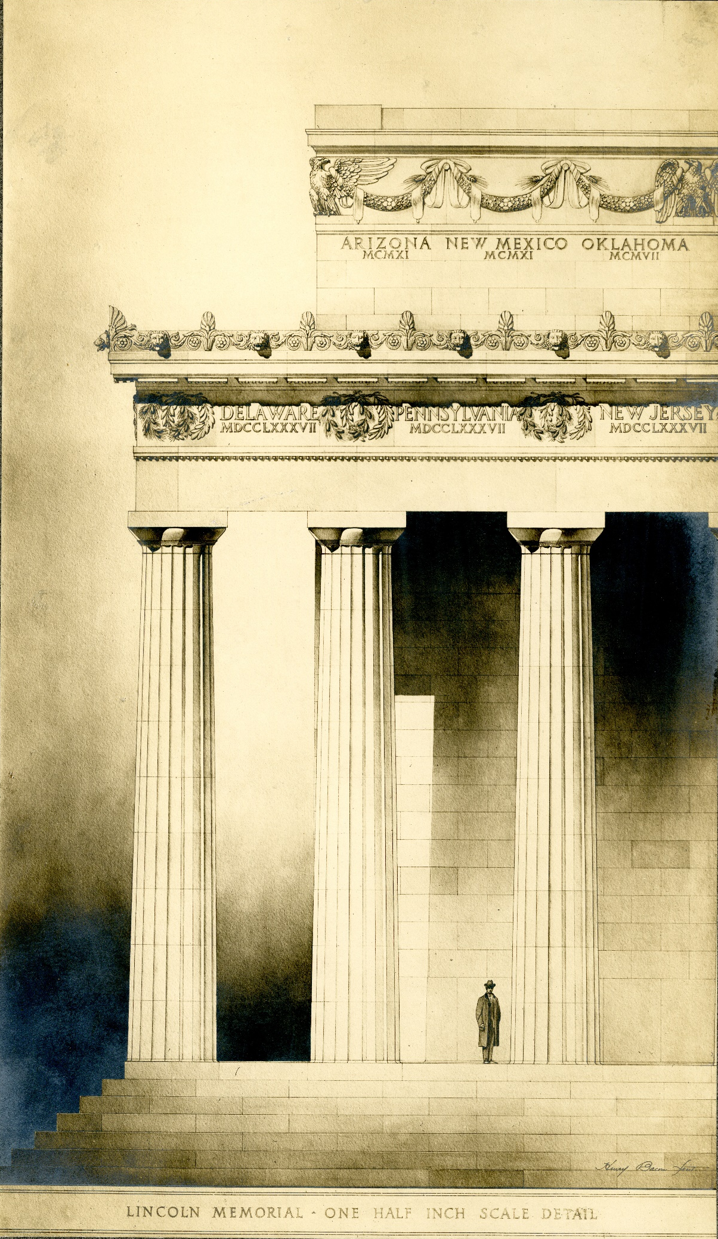
Set variable resource type
rule “set resource type”
when
exist "//*[local-name()='type'][1]/text()"
then
copy "//*[local-name()='type'][1]/text()“
to "dc"."type"
end
Notes:
Here I want a variable resource type, based on the value in the type field.
I’m taking the value from “type” and putting into dc.type
then you need to have those values mapped in the Dublin Core Type to Discovery Type Mapping table
Image from: https://digitalcollections.wesleyan.edu/islandora/08007007-photographs-other-plans-delaware-corner
Bacon, Henry. Photographs of other plans, Delaware corner. 1886 to 1924. Henry Bacon Papers, Series V, Lincoln Memorial, Subseries V D, Construction, Box 8, Special Collections & Archives, Wesleyan University.

Slide 30
Using Discovery Normalization Rules
Notes:
Image from: https://digitalcollections.wesleyan.edu/object/upc-650
Scenic [College Row], 1959, University Photographer’s Collection, Special Collections & Archives, Wesleyan University.

Slide 31
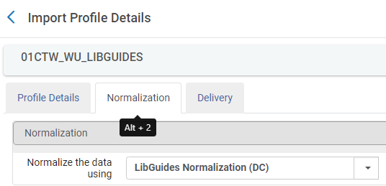
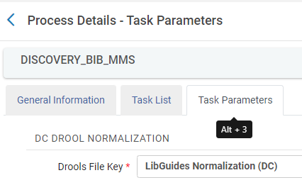
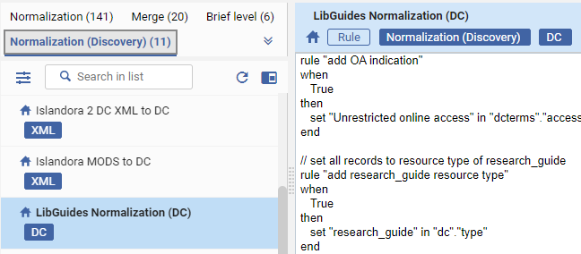
Utilize the Normalization Rules in Discovery Import Profiles
A Discovery Import Profile
Uses a Normalization Process
Which contains Normalization Rule Set(s)
Notes:
It’s a few steps to get your normalization rules connected to your discovery import profile.
In the Discovery Import Profile the Normalization Tab uses a Normalization Process. The Normalization Process has tasks which are made up of your normalization rule set(s).

Slide 32
Create Normalization Rule Process with Wizard (animation)
Alma >Config > Discovery > Loading External Data Sources > Normalization Process Task > Add Process
Animation of process: https://drive.google.com/file/d/1Ve-MaUbMDD6imSZIJtf2zMafA3TYUnrG/view?usp=drive_link
Notes:
A normalization rule process is a process that runs one or more normalization rule sets.
You need to create this process to be able to add the norm rules to your discovery import profile – you can’t just add the rules directly.
Here is how to create a Normalization Rule Process.
Alma >Config > Discovery > Loading External Data Sources > Normalization Process Task > Add Process
Wizard to complete the rule process setup:
1. Process details
Business entity: Discovery bib records
Type: Choose Discovery DC normalization or Discovery generic XML normalization based upon whether you have created XML or DC rules
2. Process details - General Information
Name, description, and active/inactive
3. Process Details - Add Task
and empty screen! choose the Add task button on the right
You’ll get only one option, which depends upon whether you’ve selected to create an XML or DC rule process
Whichever you are offered check the box and click Add.
You’ll need one task per norm rule, so if you’ve put them all into one rule set just add one task. If you’ve created multiple rule sets, add a task for each rule set.
4. Process Details - Task Parameters
For each task that you added, use the drop-down to select a rule set for it.

Slide 33
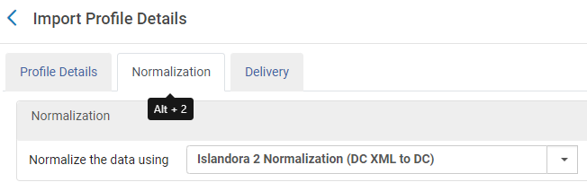
Add Norm Rule Process to your Discovery Import Profile
Alma > Config > Discovery > Loading External Data Sources > Discovery Import Profiles > (choose your profile) > Normalization tab > choose your normalization process
Notes:
Here is how to ad the normalization process to your Discovery Import Profile.
Alma > Config > Discovery > Loading External Data Sources > Discovery Import Profiles > (choose your profile) > Normalization tab >
Choose your process

Slide 34
Testing Discovery Normalization Rules
Notes:
Image from: https://digitalcollections.wesleyan.edu/object/upc-650
Scenic [College Row], 1959, University Photographer’s Collection, Special Collections & Archives, Wesleyan University.

Slide 35
Some Methods of Testing Norm Rules
From the norm rules testing tool
Harvest subsets
View records in Primo
Notes:
There are multiple ways to test
You can do all of this on a sandbox (doesn’t have to be premium) to test harvesting using the normalization rules/processes you’ve defined before doing it on production.
You can also do all of this on production, but if you have access to a sandbox, always better to do it there!
Image from: https://digitalcollections.wesleyan.edu/object/wes-covid19%3A57
Eaton, Liza. Untitled. April 01, 2020. Wesleyan University collection on COVID-19, Special Collections & Archives, Wesleyan University.

Slide 36
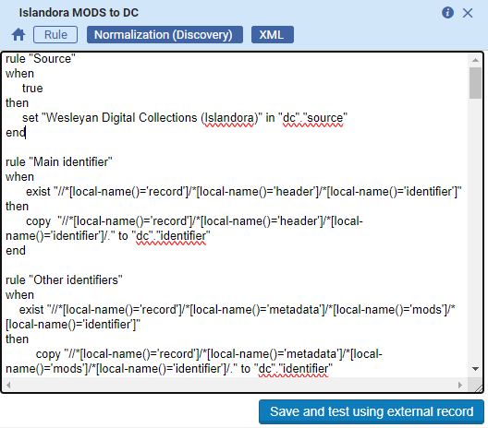
Testing: Norm Rules Testing Tool (animation)
Animation of process: https://drive.google.com/file/d/1VdWY4btEADgt-nf7AdgJqVDfvCdRMFrX/view?usp=drive_link
Notes:
Using the Normalization Rule testing tool in Alma. This doesn’t actually do any harvesting of records, just shows you how they would be altered
I need to have a text file that has the XML of the record I want to use in my test. I only need the parts between the <record> tags and I’ve just grabbed this from my OAI feed.
Animation…
To get to the testing tool, from the Discovery Config menu you can either choose Test Normalization Rule or you can go into the rule editor and choose Save and Test using external record.
In the testing page you’ll select whether you are processing it as a DC or Generic XML record, browse to the file you want to use – remember to hit upload! Then the record will appear in the Source Record box on the left.
Then select whether you want to run a norm rule or a norm rule process on it. If I’m testing a complex rule that I think is going to require a lot of testing and tweaking I’ll isolate that to it’s own rule set and test just that one rule separately until I get it working how I want, then push into the rule set and/or norm rule process and test my rules together.
Click Run test and the output of the rules will appear in the Normalized Record box.
Issues that come up:
you may see “no records were found” in the normalized record box. That means it doesn’t like the format of your source record. It only needs the <record></record> portions, not all the OAI headers and stuff
See example record files from Wesleyan sources in the github: https://github.com/lstethers/primove-normrules/tree/main/presentation-files

Slide 37
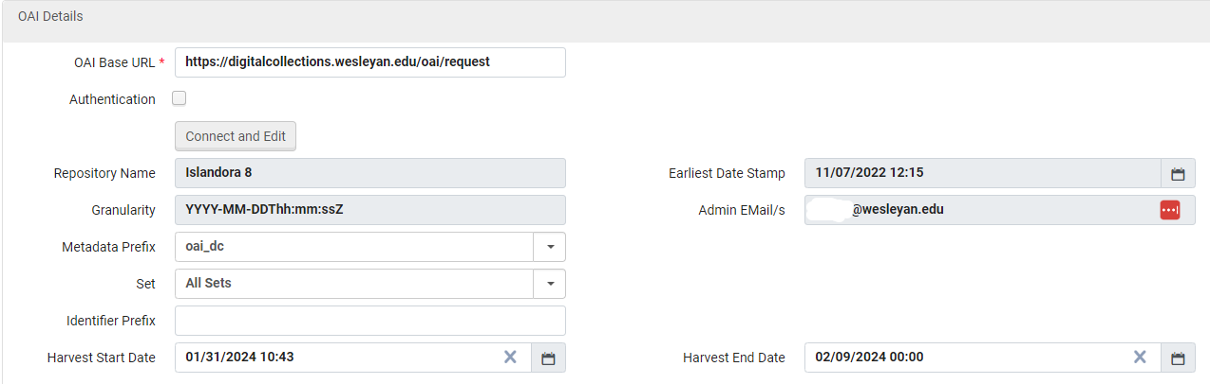
Testing: Harvest subsets
If you don’t want to test your rules on the whole set of data, you can limit by date or set name.
Notes:
In the Discovery Import Profile, you can limit what records you harvest by sets (if your data source has sets) or by harvest start and end dates, perhaps just harvesting records modified in a particular day or week.
You can do this on the sandbox if you don’t want to harvest the entire data set from your source, but just want to test a small number of records.
You could also do this to test a subset of records on production before harvesting everything.
Remember to reset your harvest start date or set name when you want to harvest everything!

Slide 38

Testing: Repeating Harvests
When repeating test harvests, you will need to:
Reset the harvest start date on your import profile
and
Either:
Use the “Reload and Delete” option on the import profile
Use Admin > Run a Job > Delete External Data Sources to delete the records, then run the import profile
Notes:
If you run your discovery import OAI profile either in full or to harvest a subset, the next time you run a harvest it will only harvest records added or modified since the prior harvest date/time.
Therefore you need to reset your harvest date back to a prior date if you want to reharvest the same records or the entire set.
You should either use the import profile’s Reload and Delete or the Delete External Data Sources job to delete the already harvested records from Primo.
Documentation for Delete External Data Sources job: https://knowledge.exlibrisgroup.com/Primo/Product_Documentation/020Primo_VE/Primo_VE_(English)/100Loading_Records_from_External_Sources_into_Primo_VE/Deleting_External_Data_Sources_for_Primo_VE
Image from: http://library.nyam.org/colorourcollections/wp-content/uploads/sites/5/2018/02/WesleyanUniversity_ColorOurCollections_2018.pdf
Piso, Willem, 1611-1678. … De Indiæ utriusque re naturali et medica libri quatuordecim … Amsterdam: Elzevir, 1658. Special Collections & Archives, Wesleyan University.

Slide 39
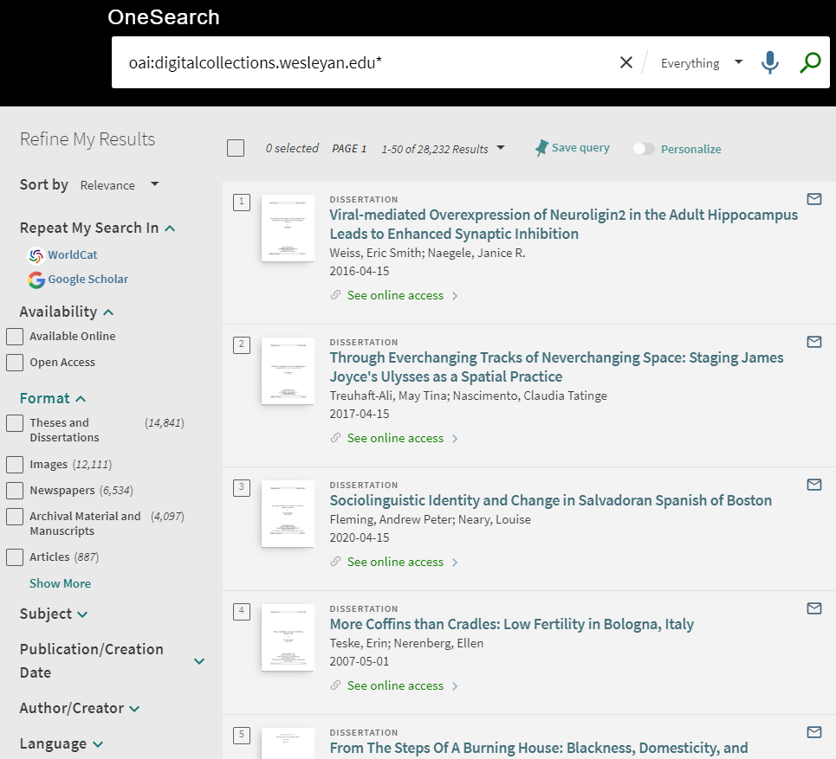
Testing: Primo records overall
Search for your identifier prefix and look for…
Facets:
Resource types, esp “Other”
Unexpected facet values
Records:
Total # of records
Records without titles
Open access indicators
Notes:
If you wait for the records to be indexed and then search you can search for individual records, but I find it most useful to retrieve everything harvested from that data source and I do that by searching for the identifier prefix. you can see that in the example shown here.
Here I’ve searched for my identifier prefix to get all records from this data source.
I’m looking at the facets to check for:
“other” resource type – are there additional resource types that should be mapped?
weird subjects, authors, pub dates
I’m looking at search results to check for:
records without titles,
appearance of open access indicators,
correct resource types

Slide 40
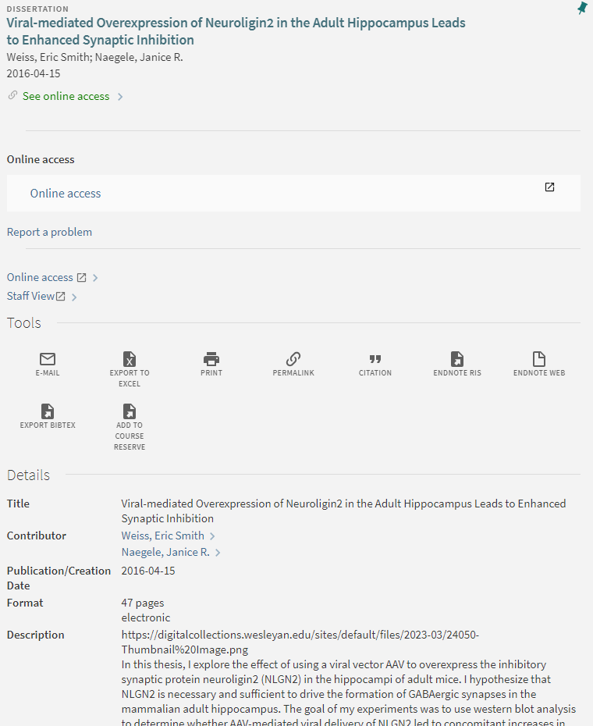
Testing: Primo full record details
Data present, accurate, and formatted correctly
Unwanted fields
Extraneous data
Online access link
Use the Staff View link to see the harvested and normalized DC record
Notes:
Are the data in the record details present? Are they formatted correctly? Are any of your expected fields missing?
Does the online access link work? (that’s defined in the import profile, but you might be feeding it from a norm rule)
Are any unwanted fields or data showing up?
You can use the Staff View link to see the DC that Primo has for this record after normalization - really helpful for troubleshooting

Slide 41
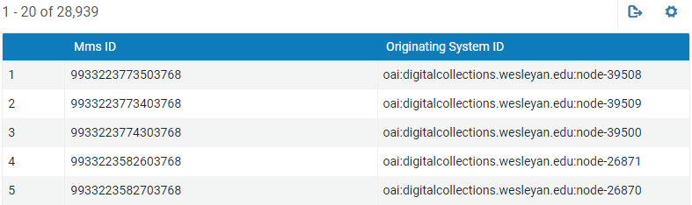
Testing: View records in Primo immediately (animation)
Get newly loaded records’ MMS IDs from the Harvest log
Discovery Import Profile > Ellipses menu on your profile > History > Ellipses menu next to the job you just ran > Report > Report table > Ellipses next to New Records Added > Preview records
Use the MMS ID to build a URL to the Primo record
Animation of process: https://drive.google.com/file/d/1Vd2n3y8ihZln6DQU4OAfc_qk0tkJimmU/view?usp=drive_link
Notes:
However if you want to look at your records right away, you can go to the
Discovery Import Profile > Ellipses menu on your profile > History > Ellipses menu next to the job you just ran > Report > Report table > Ellipses next to New Records Added > Preview records – it will show the MMS ID and originating system identifier for all the added records.
Then you can use the MMS ID to build a URL to get directly to the full record in Primo:
https://onesearch.wesleyan.edu/discovery/fulldisplay?docid=alma9933223773503768&vid=01CTW_WU:CTWWU

Slide 42
Additional Resources
Notes:
Image from: https://digitalcollections.wesleyan.edu/object/upc-650
Scenic [College Row], 1959, University Photographer’s Collection, Special Collections & Archives, Wesleyan University.

Slide 43
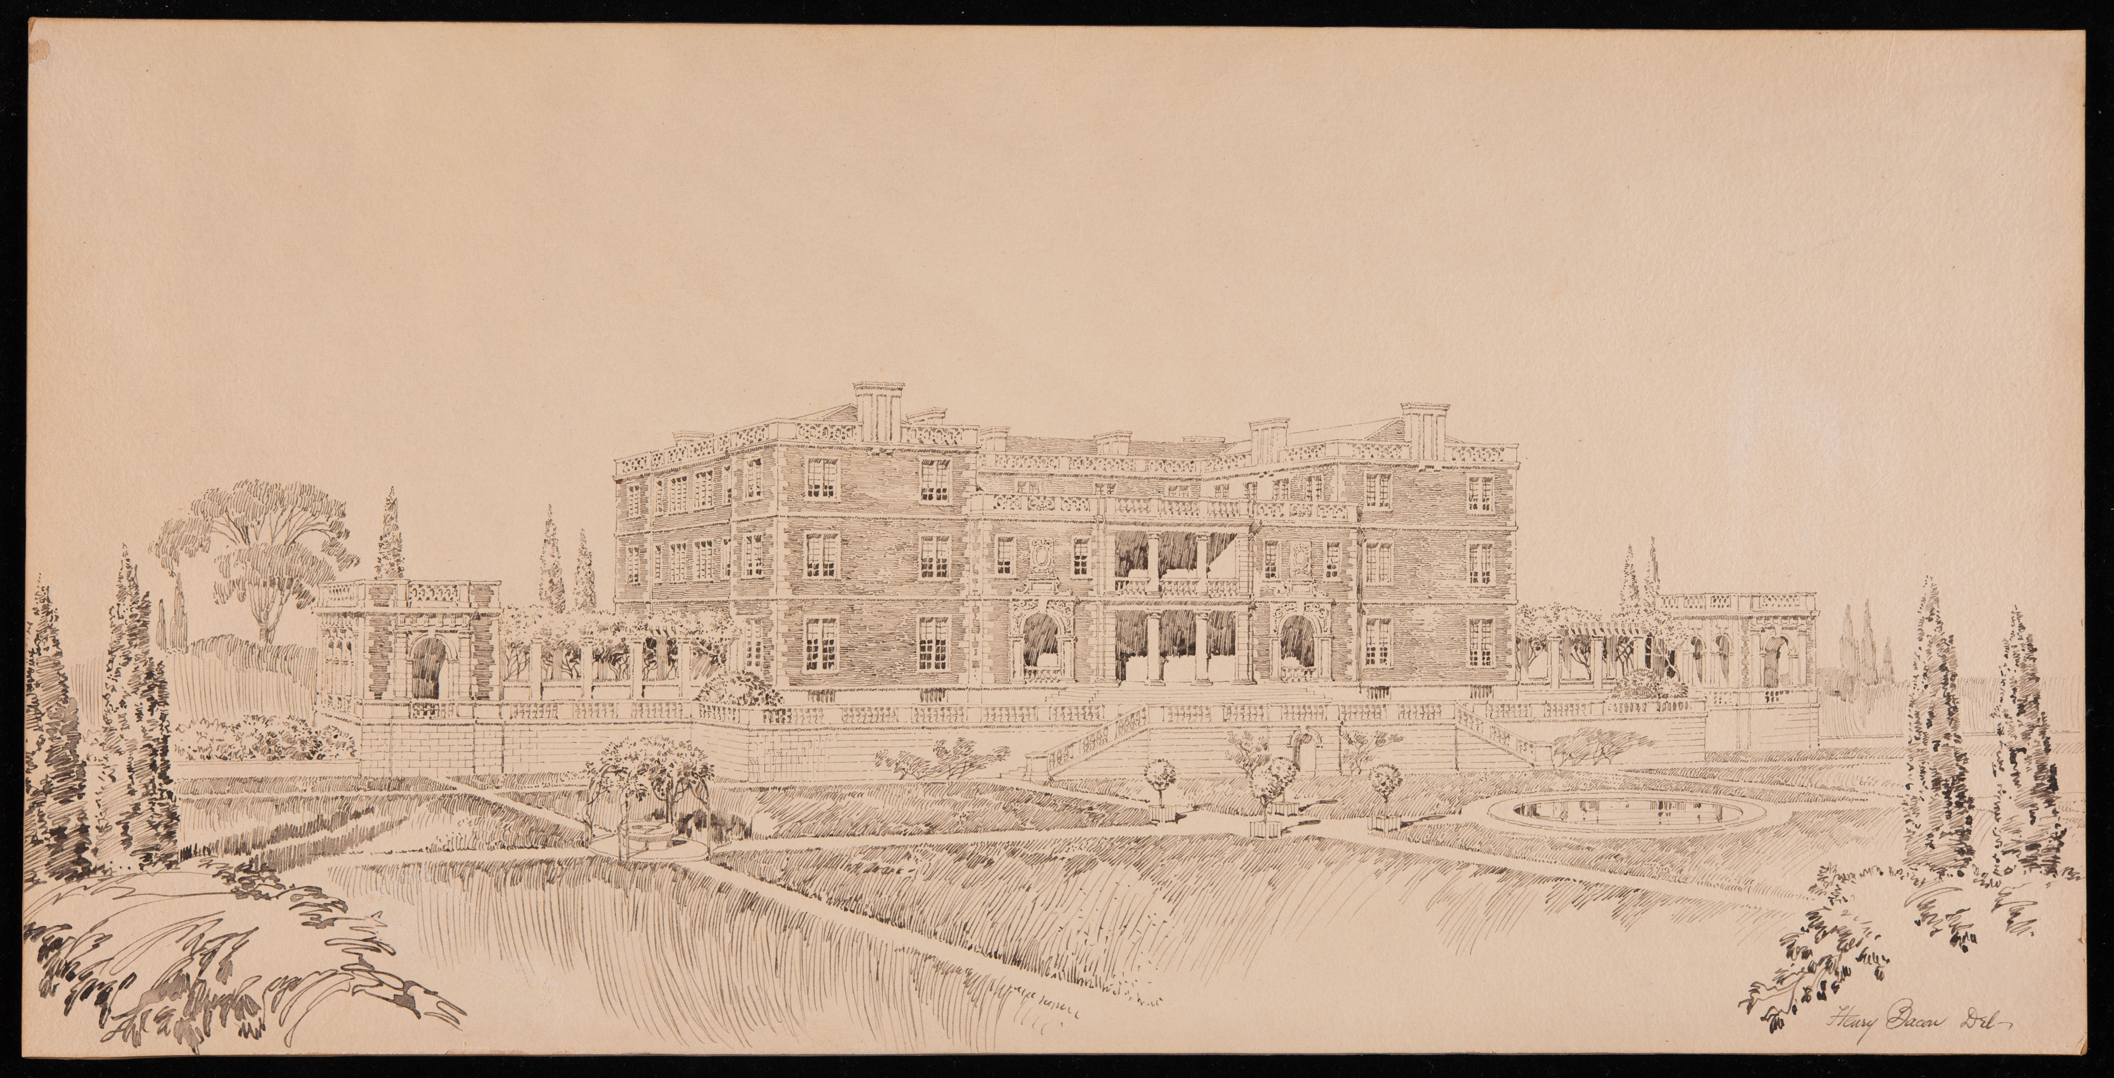
Ex Libris Resources
Loading Records from External Sources into Primo VE
Configuring Normalization Rules for External Resources (Primo VE)
Mapping to the Display, Facets, and Search Sections in the Primo VE Record (Dublin Core)
Notes:
https://knowledge.exlibrisgroup.com/Primo/Product_Documentation/020Primo_VE/Primo_VE_(English)/100Loading_Records_from_External_Sources_into_Primo_VE
https://knowledge.exlibrisgroup.com/Primo/Product_Documentation/020Primo_VE/Primo_VE_(English)/100Loading_Records_from_External_Sources_into_Primo_VE/Configuring_Normalization_Rules_for_External_Resources_(Primo_VE) https://knowledge.exlibrisgroup.com/Primo/Product_Documentation/020Primo_VE/Primo_VE_(English)/120Other_Configurations/Mapping_to_the_Display%2C_Facets%2C_and_Search_Sections_in_the_Primo_VE_Record#Dublin_Core
Image from: https://digitalcollections.wesleyan.edu/islandora/09001001-large-house-garden-front
Bacon, Henry. Large house with garden, front. 1886-1924. Henry Bacon Papers, Series VI: Personal, Subseries VI B: Sketches and watercolors of European scenes, Special Collections & Archives, Wesleyan University.

Slide 44
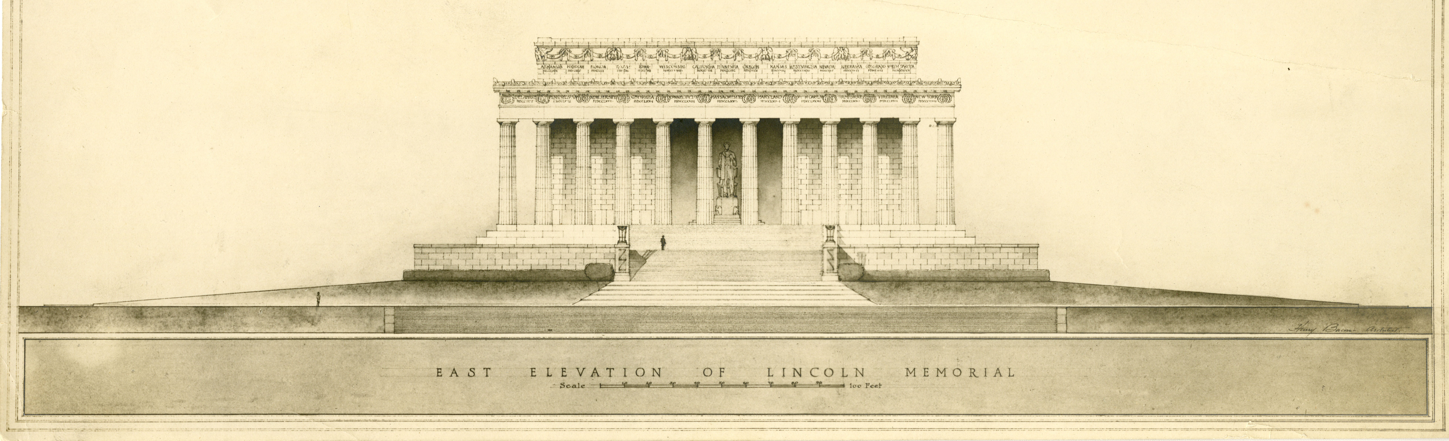
Community Resources
W3 schools XPath tutorial
XPath 1.0
Primo VE Norm Rule wiki and associated Rule Repository on github
Community Knowledge Entry with norm rules for transforming MODs
Mike Wan’s github of norm rules
“Community” rules in the Norm Rule Editor
Notes:
https://www.w3schools.com/xml/xpath_intro.asp
https://www.w3.org/TR/1999/REC-xpath-19991116/
ELUNA Primo Working Group’s Discovery Import Normalization Rules Project Team made the wiki and rule repository:
https://github.com/primousers/primo-ve-norm/wiki/
https://github.com/primousers/primo-ve-norm
https://knowledge.exlibrisgroup.com/Alma/Community_Knowledge/Generic_XML_Normalization_Rules_and_XPath_Tips
https://github.com/mwan-work/PrimoVE-External-Data-Normalization/tree/main
Image from: https://digitalcollections.wesleyan.edu/islandora/08007002-photographs-other-plans-east-elevation
Bacon, Henry. Photographs of other plans, East elevation. 1886-1924. Henry Bacon Papers, Series V, Lincoln Memorial, Subseries V D, Construction, Box 8, Special Collections & Archives, Wesleyan University.

Slide 45

Questions?
Lori Stethers Systems Librarian, Wesleyan University lstethers@wesleyan.edu https://github.com/lstethers/primove-normrules/
ELUNA, May 2024
Notes:
Image from: http://library.nyam.org/colorourcollections/wp-content/uploads/sites/5/2018/02/WesleyanUniversity_ColorOurCollections_2018.pdf
Olin Memorial Library, 1928, Vertical Files Photograph Collection, Special Collections & Archives, Wesleyan University

Slide 46
Bonus Content
Notes:
Images:
https://digitalcollections.wesleyan.edu/object/coeducation-13
https://digitalcollections.wesleyan.edu/object/wilburolinatwater-8 -- pineapple plantation
https://digitalcollections.wesleyan.edu/object/vertical-85 -- mlk
https://digitalcollections.wesleyan.edu/islandora/08007002-photographs-other-plans-east-elevation
http://library.nyam.org/colorourcollections/wp-content/uploads/sites/5/2018/02/WesleyanUniversity_ColorOurCollections_2018.pdf
valid conditions for both DC and XML:
true – Unconditionally applies the rule to all records.
exist – Applies the rule when a specific field exists.
not exist – Applies the rule when a specific field does not exist.
equals – Applies the rule when the entire contents of the specified field match.
not equals – Applies the rule when the entire contents of the specified field does not match.
DC Actions:
copy – Copies the value from one field to another field.
move – Moves the value from one field to another field.
remove – Removes the value from a field.
set – Sets the value of a field directly.
XML Actions:
copy – Copies the value from one field to another field.
copy all - import more than one instance of a field (such as creator or ISSN) based on a specific separator. To utilize this action, you must create a normalization rule for each instance of the field that you want to support.
set – Sets the value of a field directly.
Transformations (XML and DC):
remove substring using regex
concatenate with delimiter
add prefix
add suffix
replace string by string
return list using regex
remove string
remove leading and trailing spaces
replace spaces
lower case

